Slide 1

Welcome!
Our Event Will Begin Shortly

Slide 2

The World has Forever Changed
We are in a “work from anywhere” revolution.
Today people are looking for:
More Income
More Time
More Flexibility
Independence
In these uncertain times, doesn’t it make sense to have a backup plan?

Slide 3

Are you working for the right kind of income?
3 forms of income
Linear income – trading time for money
Leveraged income – work with team, unlimited income potential
Residual income – your retirement plan

Slide 4
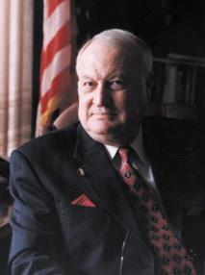






Established in 1972
PROTECTING & EMPOWERING
4.5 million lives & businesses with a dedicated network of quality law firms in the U.S. & Canada.
Our Vision
To build a BETTER WORLD where access
to JUSTICE is EQUAL for every human.

Slide 5

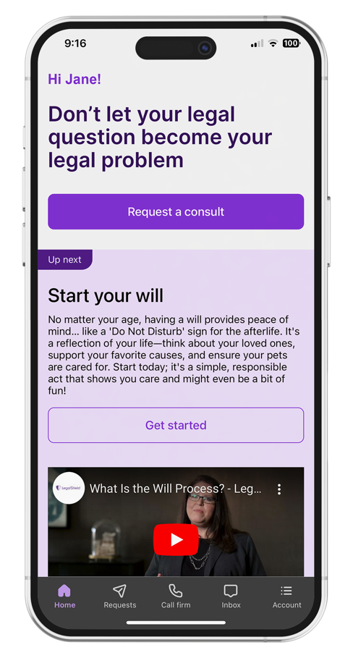
Preferred Legal Plan
Covers member, spouse, and eligible dependent children.
Consultation Unlimited number of personal legal
matters.
Letters or Phone Calls Made on your behalf.
Document Review Unlimited personal legal
documents up to 25 pages each.
Residential Loan Document Review Primary
residence.¹
Residential Tenant Lease Advice, review of
documents and negotiations with a landlord.
Preparation, Annual Reviews and Updates
Will
Durable Power of Attorney
Physician’s Directive/Living Will
Traffic Ticket Assistance Advice and consultation, plus two (2) covered violations per year, per person.²
Property Damage Assistance³
Civil Trial Defense Subject to schedule of hours for covered matters.
IRS Audit Assistance Consultation, audit representation and pre-trial negotiation.
Uncontested
        Minor Child Adoption¹
Name Change
Civil Annulment or Separation or divorce⁴
Prenuptial and Post-nuptial Preparation⁴
24/7 Emergency Access if your rights are being
denied or threatened (for covered emergencies).
Online Notarization Up to (5) per membership year.
E-Signature Unlimited.
25% Discount Off the Provider Law Firm’s standard hourly rate.
This is a general overview of the legal plan coverage available from Pre-Paid Legal Services, Inc. (“PPLSI”) for illustration purposes only. In New York and Nevada an additional fee may be required for some services. See a legal plan details for pre-trial/trial time hours that may apply. Uncontested services have a 180-day waiting period.
1 Primary member and spouse only. 2 $79 fee each time the lawyer makes a court appearance. 10 day waiting period. 3 Can receive when a driver or passenger in or struck by a motor vehicle. Claims $5,000 or less. 4 Primary member only.

Slide 6
Preferred Legal Plan
$39.95 per month - Covers member, spouse, and eligible dependent children.
Consultation Unlimited number of personal legal
matters.
Letters or Phone Calls Made on your behalf.
Document Review Unlimited personal legal
documents up to 25 pages each.
Residential Loan Document Review Primary
residence.¹
Residential Tenant Lease Advice, review of
documents and negotiations with a landlord.
Preparation, Annual Reviews and Updates
Will
Durable Power of Attorney
Physician’s Directive/Living Will
Traffic Ticket Assistance Advice and consultation, plus two (2) covered violations per year, per person.²
Property Damage Assistance³
Civil Trial Defense Subject to schedule of hours for covered matters.
IRS Audit Assistance Consultation, audit representation and pre-trial negotiation.
Uncontested
        Minor Child Adoption¹
Name Change
Civil Annulment or Separation or divorce⁴
Prenuptial and Post-nuptial Preparation⁴
24/7 Emergency Access if your rights are being
denied or threatened (for covered emergencies).
Online Notarization Up to (5) per membership year.
E-Signature Unlimited.
25% Discount Off the Provider Law Firm’s standard hourly rate.
This is a general overview of the legal plan coverage available from Pre-Paid Legal Services, Inc. (“PPLSI”) for illustration purposes only. In New York and Nevada an additional fee may be required for some services. See a legal plan details for pre-trial/trial time hours that may apply. Uncontested services have a 180-day waiting period.
1 Primary member and spouse only. 2 $79 fee each time the lawyer makes a court appearance. 10 day waiting period. 3 Can receive when a driver or passenger in or struck by a motor vehicle. Claims $5,000 or less. 4 Primary member only.

Slide 7
TOP 20 REASONS A BUSINESS NEEDS LegalShield
Unlimited legal consultations – Call an attorney before making important business decisions instead of after a problem arises.
Contract review – Have customer, vendor, lease, or partnership agreements reviewed before signing.
Collection letters – Attorneys can send demand letters to customers who owe your business money, often increasing the chances of getting paid.
Debt collection assistance – Get guidance on collecting overdue invoices while staying within the law.
Business formation guidance – Receive legal advice when forming an LLC, corporation, or partnership.
Employment law questions – Get answers about hiring, firing, employee policies, independent contractors, overtime, and workplace issues.
Vendor disputes – Have an attorney help resolve disagreements with suppliers or contractors.
Customer disputes – Get legal guidance when customers threaten legal action or refuse payment.
Lease review – Before renting office, retail, or warehouse space, have an attorney review the lease.
Document review – Have legal documents reviewed before you sign or send them.

Slide 8
Attorney-written letters and phone calls – Sometimes a letter or call from a lawyer quickly resolves disputes without going to court.
Compliance guidance – Get help understanding federal, state, and local business regulations.
Protect your intellectual property – Receive guidance on trademarks, copyrights, branding, and business names.
Reduce legal costs – Instead of paying $300–$600+ per hour, many covered services are included in your monthly membership.
Business continuity – Get legal advice during expansions, relocations, acquisitions, or ownership changes.
Tax-related legal questions – Speak with an attorney about legal aspects of business tax matters (while using a CPA for tax preparation).
Independent contractor agreements – Make sure agreements properly protect your business.
Peace of mind – Know you have a law firm to call whenever legal questions arise, without worrying about the cost of every phone call.
Save time – Get quick legal answers instead of spending hours searching online or hoping you interpret the law correctly.
Risk prevention – The biggest value is often preventing costly mistakes before they become lawsuits.

Slide 9
Why many small business owners find value
The most successful business owners often use attorneys proactively rather than reactively. Having affordable access to legal advice makes it much more likely they’ll ask questions before:
Signing a contract
Hiring an employee
Leasing property
Sending a demand letter
Responding to a legal threat
Entering a partnership

Slide 10
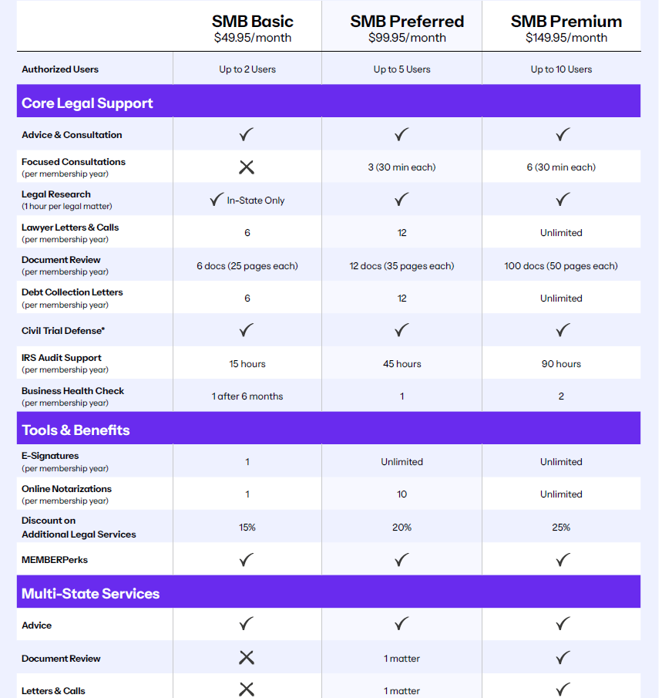
Legal protection for your business is vital.
So is having options. We offer three levels of legal protection. That way, you only pay for what you need!
PLUS, for Business Owners who also have a personal legal plan, LegalShield now offers Business Owners Coverage with a simple activation process!
Business must be a For Profit, Not Publicly Traded, and fewer than 250 employees

Slide 11
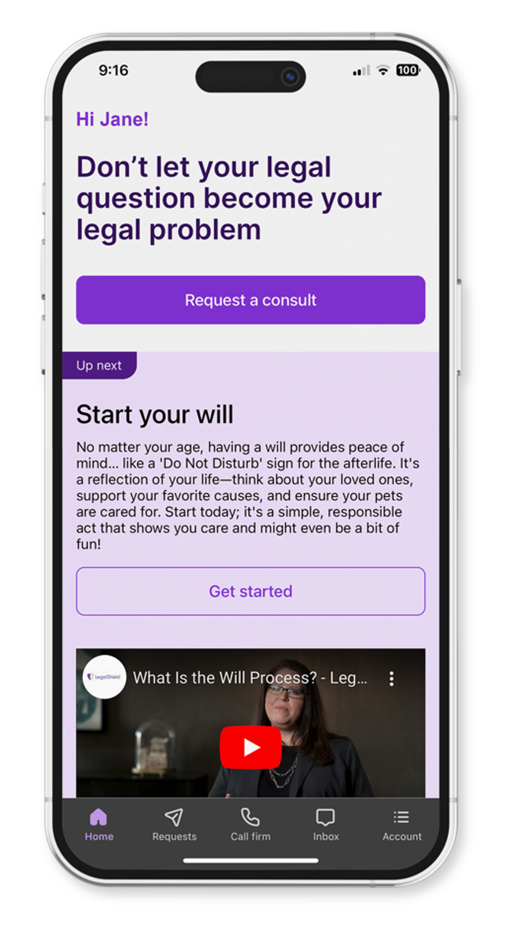
Home Business Option- $69.90/mo
Covers member and spouse only
Advice and Consultation: Unlimited number of business legal matters (1 hour of research each)
Letters or Phone Calls: Any combination of 12 letters or phone calls per membership year
Document Review: Up to 4 legal documents of up to 25 pages each month
Collection Letters: 4 per month
3 Annual Designated Phone Consultations: Up to 30 minutes each
Covers up to 2 For Profit Business Entities / Interests with Separate SSN/EIN/TIN Owned by Member or Spouse :
  Additionally, up to 2 Residential Rental Properties
  Properties must be owned by member or spouse only
  Excludes commercial or properties managed by third parties
IRS Audit Services: Schedule C & E added to hours in personal legal plan
Cannot have any employees outside of immediate family
Notes:
TO BE ELIGIBLE FOR THIS COVERAGE
YOUR HOME ADDRESS AND BUSINESS ADDRESS MUST BE THE SAME
NO PARTNERS OTHER THAN YOUR SPOUSE OR SIGNIFICANT OTHER
NO EMPLOYEES EXCEPT FAMILY

Slide 12
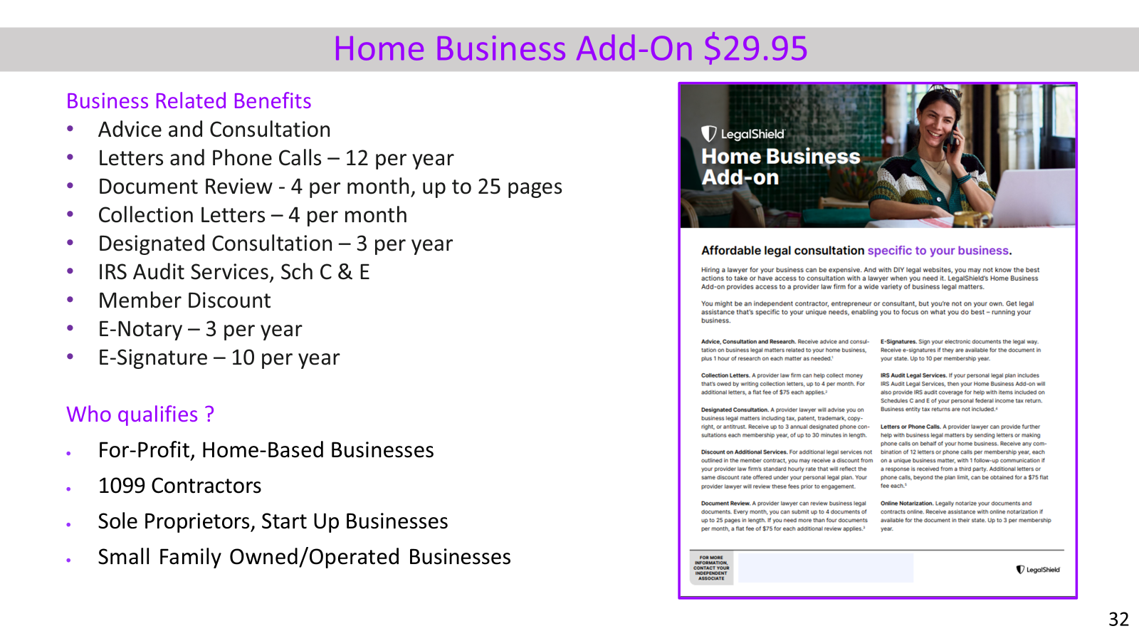

Slide 13
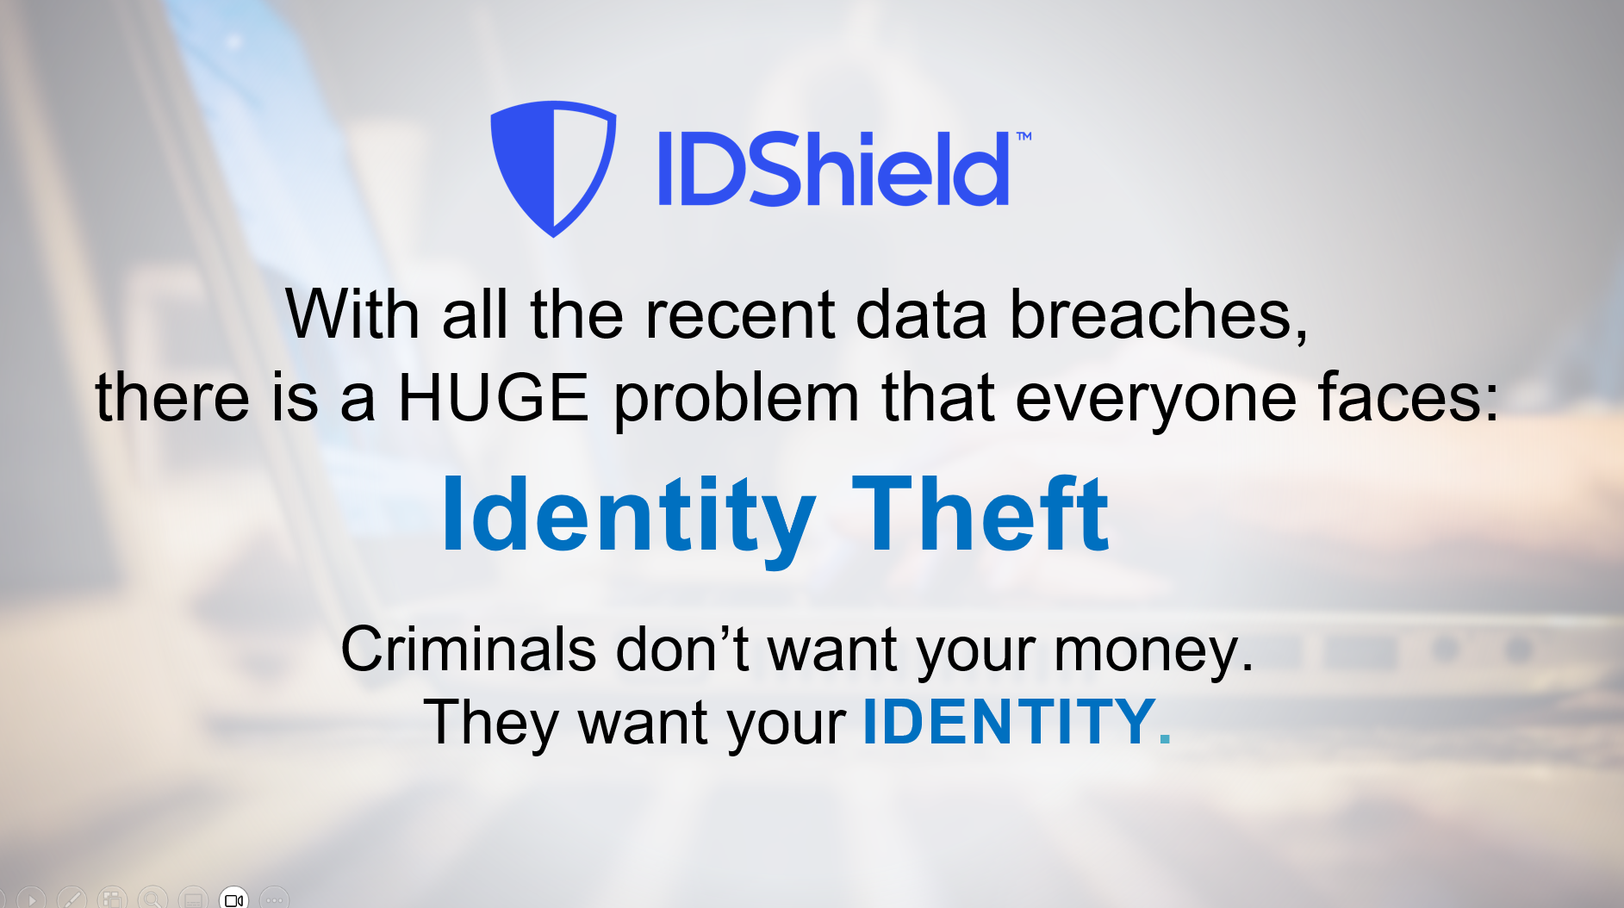

Slide 14

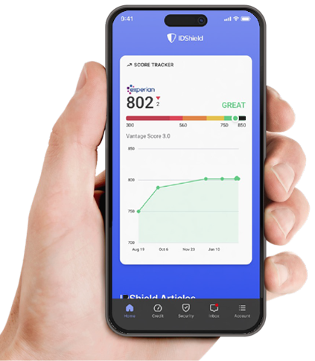
Common types of Identity Theft:
Tax returns
Medical claims
Social Security claims
Credit
Driver’s License
Criminal/Character
You are guilty until proven innocent!
Exclusions and limitations apply. Services and benefits vary by state/province. Please review a contract for complete terms, conditions and exclusions before purchase. IDShield is a product of LegalShield and provides access to identity theft protection and restoration services.

Slide 15

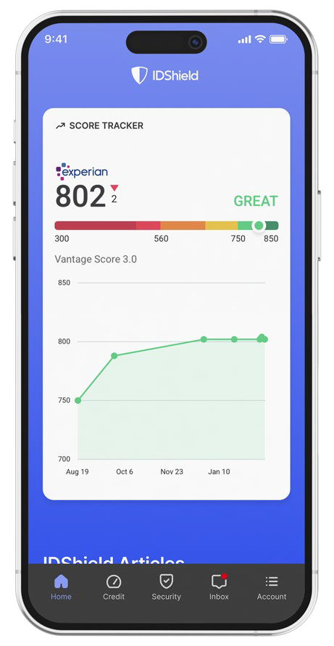

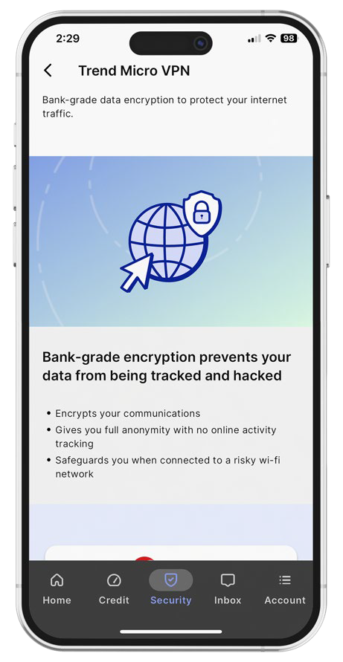
IDShield Plan
Family Plan $34.95 per month with 3 bureau monitoring
Individual Plan $19.95 per month with 3 bureau monitoring
Employee Group Rates available
Credit Score Tracker
Track your Experian credit score each month
Privacy Check
Help keep your information away from data brokers.
Trend Micro Maximum Security
VPN - Turns a public hotspot into a secure Wi-Fi connection.*
Password Manager - Multiple device protection for your digital life.**
Cybersecurity and device protection: We help protect your devices from viruses, malware, and ransomware.*
Reputation Management
Our technology scans certain social media
accounts and Google searches every week
for harmful content.
We can monitor Facebook, Instagram,
LinkedIn YouTube and X (formerly known
as Twitter).
Monitoring & Alerts
Credit Score
SSN, Passport, Driver’s License
Address, Email, Phone, DOB
Court & Public Records
Dark Web & Internet
Social Media
And More!
Financial Threshold Account Monitoring
Receive an alert on financial withdraws, balance transfers & large purchases
Identity Consultation
Identity theft specialists available 24/7 for covered emergencies.
Full-Service Restoration
By licensed private investigators.
$3M Fraud Protection
Up to $3M for covered identity theft-related losses.
Credit Cards
Checking/Savings Account
Retirement Plans
Loans
And More!
Family Plan Covers member and spouse and up to 10 dependent children under the age of 18. Provides consultation and restoration for eligible dependents up to age 26. Individual Plan Covers the member.
*All Licensed Private Investigators are licensed in the state of Oklahoma
*Individual plan covers up to three (3) devices. Family plan covers up to fifteen (15) devices. **Individual plan covers up to one (1) device. Family plan covers up to six (6) devices.

Slide 16
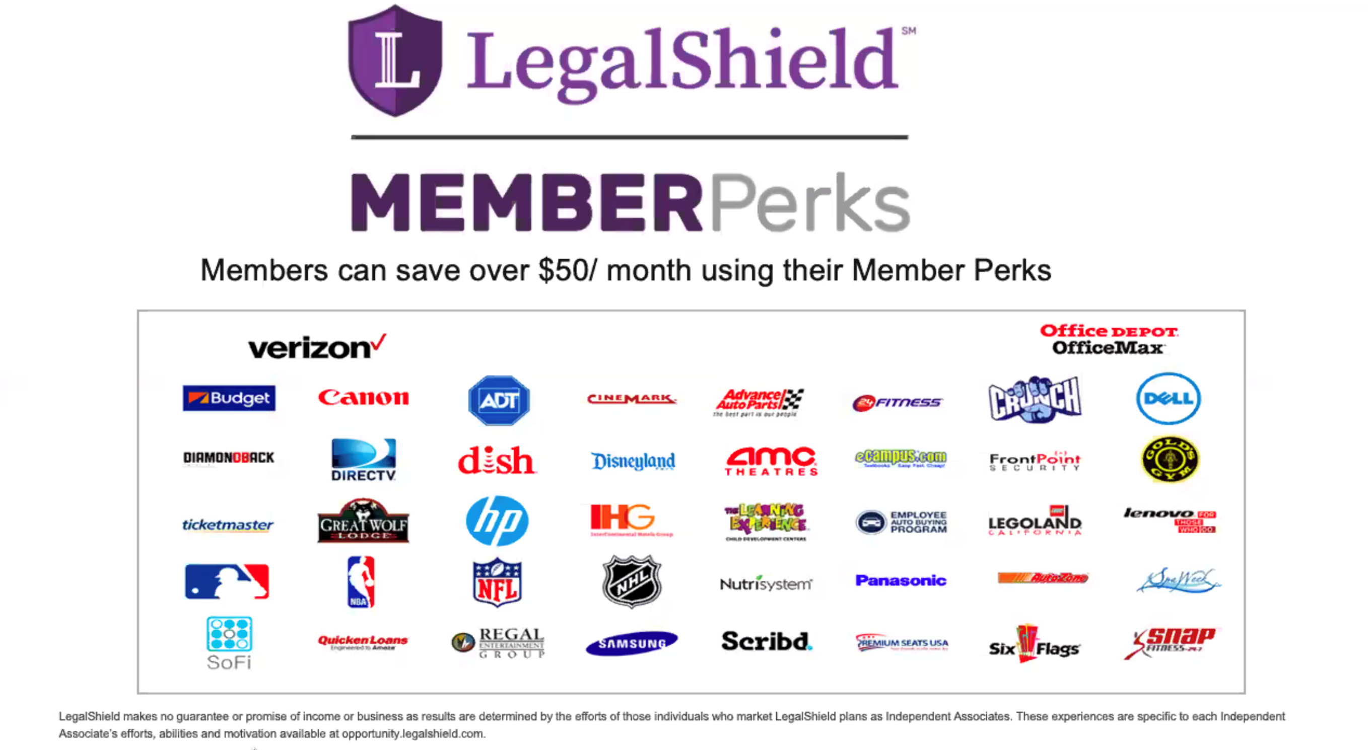

Slide 17

Is this an idea worth sharing?
Help us spread the word

Slide 18




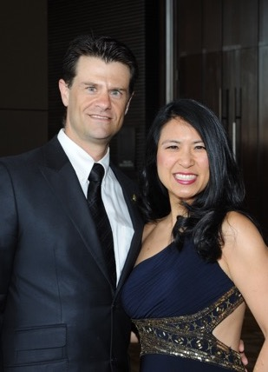
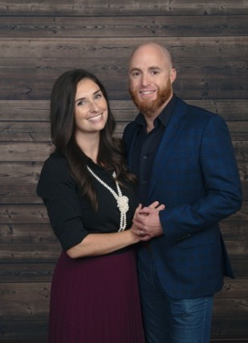
Compensation
Enroll Members
Get paid $82 – $427 per new member.
($80 at associate level up to $416 at Executive Director level)
Leveraged Income
Build a team and earn income on memberships they enroll.
Residual Income
Get paid 10% of commissions again on month 13! Earn commission every month for the lifetime of the membership.
Opportunity to Earn Bonuses
Earn up to $600 in your first 45 days.
Brian & Melissa Carruthers
REAL ESTATE
Darnell & Traci Self
RETAIL
Alex & Julia Shahid
STUDENTS
Anita Sarda
BUSINESS
Liz & David Lequeux
SALES
Daniel & Rebecca Gonzalez
HEALTHCARE
Individual results may vary. Pre-Paid Legal Services, Inc. ("LegalShield") makes no guarantees on income or success. Average 2023 compensation for active LegalShield Independent Sales Associates was approximately $2,647.89 before expenses. There’s a mandatory, one-time $49 registration fee to become an Independent Sales Associate. Optional LegalShield Advantage Plus service available for $24.95/month. This service can be cancelled at anytime. Securing career-level income with LegalShield is not typical and requires sustained hard work and dedication. Please see LegalShield’s Income Disclosure at https://www.pplsi.com/income-disclosure/ for more earnings and expense information.

Slide 19
How to earn $1000 this week:
(Assoc --> Sr Assoc) Three $74.90 Legal / IDShield plans + 1 Associate = $246 + FSQ bonus of $200 = $446
(Sr Assoc –> MGR) 2 more Associates with $72.90 combos = $206 + ATM Bonus of $400 = $606
Total Income = $1052
Basically Enroll 5 Customers w/ Combo Package and 3 of them as Associates

Slide 20
Commissions (Based on $39.95 Preferred Legal + $34.95 IDShield)
Your Level
Personal Income
Team Override
Executive Director*
$427
$87 +
Senior Director*
$340
$87 +
Director
$253
$70 +
$345
Bonus
Senior Manager
$183
$47 +
$400¹ (45 Days)
Manager
$136
$33 +
$200² (20 Days)
Senior Associate
$103
$21
1 Advance to Manager
2 Fast Start Qualify
Associate
$82
*Based on Elite Level Commissions
Individual results may vary. Pre-Paid Legal Services, Inc. ("LegalShield") makes no guarantees on income or success. Average 2023 compensation for active LegalShield Independent Sales Associates was approximately $2,647.89 before expenses. There’s a mandatory, one-time $49 registration fee to become an Independent Sales Associate. Optional LegalShield Advantage Plus service available for $24.95/month. This service can be cancelled at anytime. Securing career-level income with LegalShield is not typical and requires sustained hard work and dedication. Please see LegalShield’s Income Disclosure at https://www.pplsi.com/income-disclosure/ for more earnings and expense information.

Slide 21
Commissions (Based on 39.95 Legal & 34.95 IDS)
(Based on $99 Preferred Small Business Plan)
+ Residual Income
Your Level
Personal Income
Team Override
Executive Director*
$427 / $570
$87 / $116
Senior Director*
$340 / $453
$87 / $116
Director
$253 / $337
$70 / $93
$345 / $460
Bonus
Senior Manager
$183 / $244
$47 / $63
$400 (45 Days)
Manager
$136 / $180
$33 / $43
$200 (20 Days)
Senior Associate
$103 / $137
$21 / $27
*Based on Elite Level Commissions
Associate
$82 / $109
The business opportunity information is for use by LegalShield, its affiliates and its independent associates. No guarantee or promise of increased income or business is implied. Individual results and success as an independent sales associate depends on individual effort and abilities. For statistics on actual earnings, please review the Income Disclosure Statement available at opportunity.legalshield.com.

Slide 22
The Power of B2B (Employee Benefits)
Land a company with 100 employees,
50 employees enroll
At an average $150 per, that’s $7500
PLUS RESIDUALS

Slide 23
The Power of Part Time
Protect 4 families a month with $74.90 memberships
Earn $320 – $2,164 a month
Teach 25 teammates to do the same
Earn $120,000 per year
(25 teammates x 4 sales = 100 sales x 12 months
= 1,200 sales @ $100 average override)

Slide 24


Slide 25
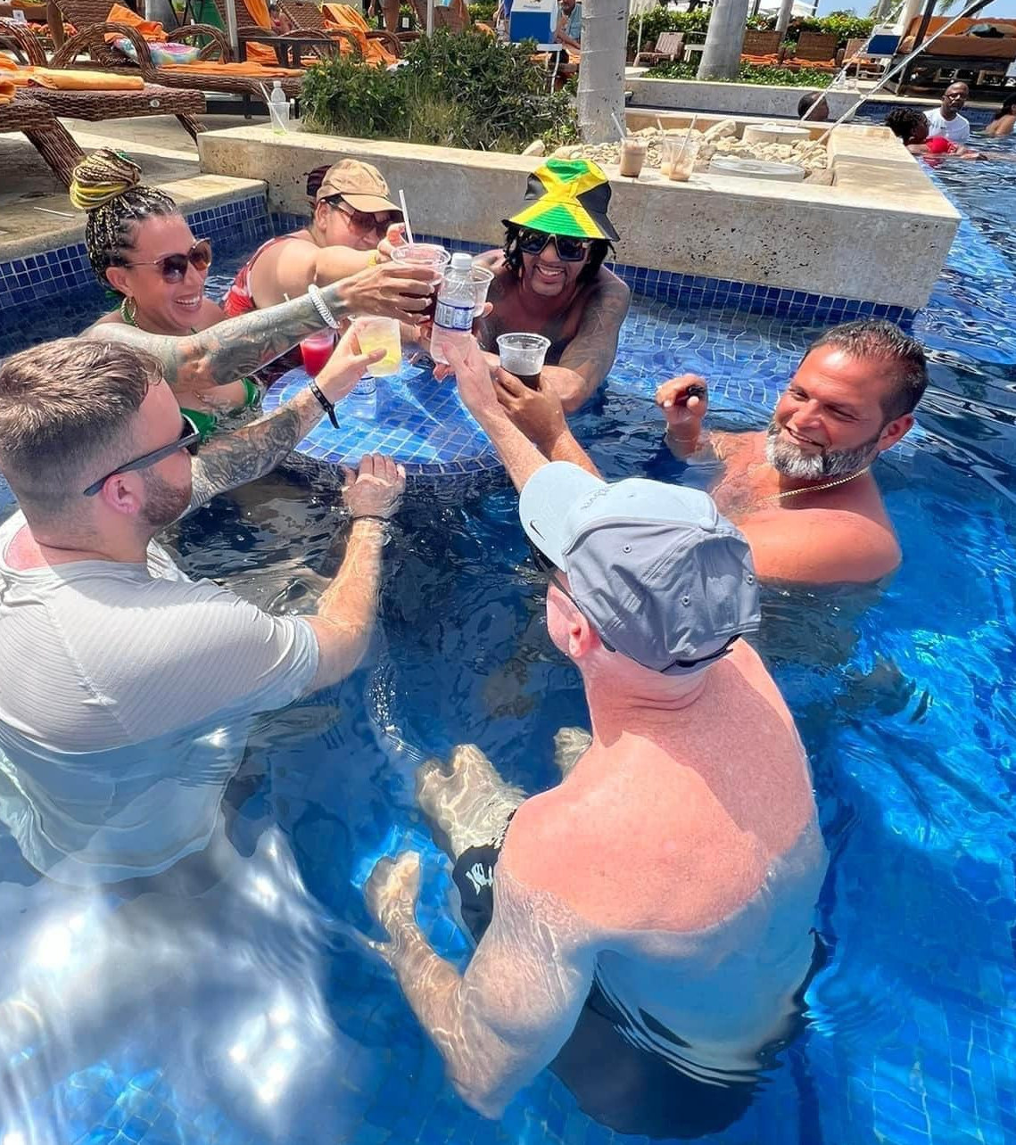
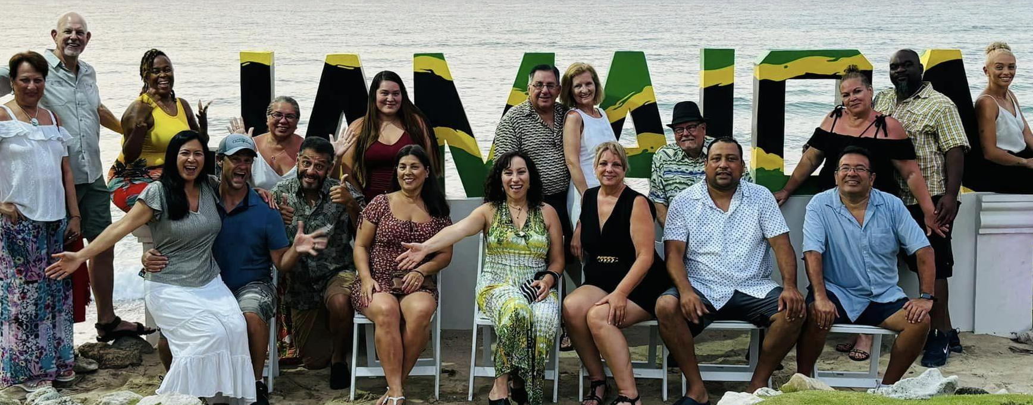

Performance Club Incentive Trips
Qualify for all expense-paid trips!
By participating in any Pre-Paid Legal Services Inc., (“PPLSI”) incentive or bonus program and to receive benefits, cash or otherwise, the associate agrees to have his/her full name, associate title, level, or standing published and recognized in PPLSI marketing materials, whether oral, written or electronic. PPLSI reserves the right, in its sole discretion, to review all incentives and bonuses, business submitted or activity, and where necessary, in its sole discretion, delay or stop payment of any bonus, to chargeback bonuses when appropriate, and to amend or revoke this incentive, or any part thereof, at any time. Please refer to your Associate Agreement and Policies and Procedures for details on incentives, bonuses or compensation as the Associate Agreement and Policies and Procedures for details on incentives, bonuses or compensation as the Associate Agreement and Policies and Procedures are the governing contract for all business between you and PPLSI. This incentive or bonus program is not a separate contract and no guarantee or promise of increased income or business is implied. Individual results and success as an independent sales associate depends on individual effort and abilities. For statistics on actual earnings please review the Income Disclosure Statement at https://www.pplsi.com/en-ca/income-disclosure/

Slide 26
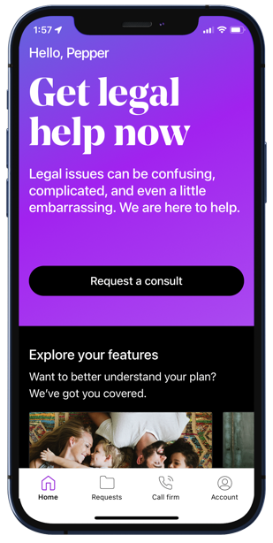
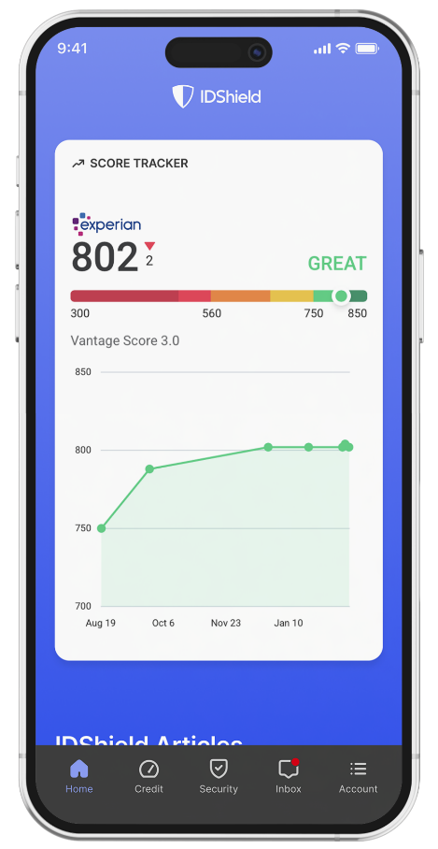
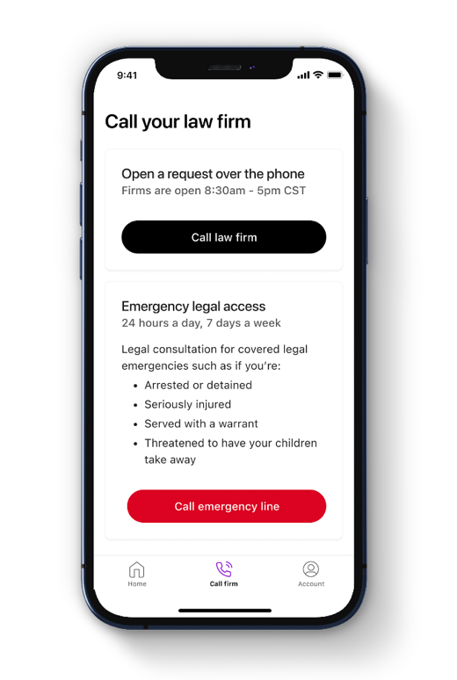




Own Your Own Business
Becoming an Associate: One-time $99
Independence - Work from anywhere
Flexibility - Set your own hours
More Income Opportunities – Linear & Leveraged
Residual income for the lifetime of the membership
Willable book of business
Opportunity to be paid daily
Success system and specialized training
Alignment with a personal mentor
Start Today!
Become a Member
Protect your family!
Protect your small business!
Become an Associate
Position yourself to generate your desired type of income!
Get with your mentor & game plan getting started!

Slide 27

“So what will I be doing?”
Tomorrow 5pm PST/ 6pm MST/ 7pm CST/ 8pm EST
www.PinnacleZoom.com
Password: 1234

Slide 28
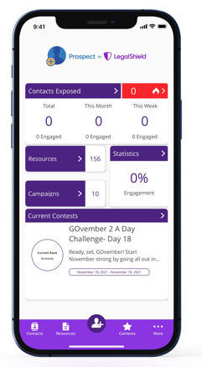
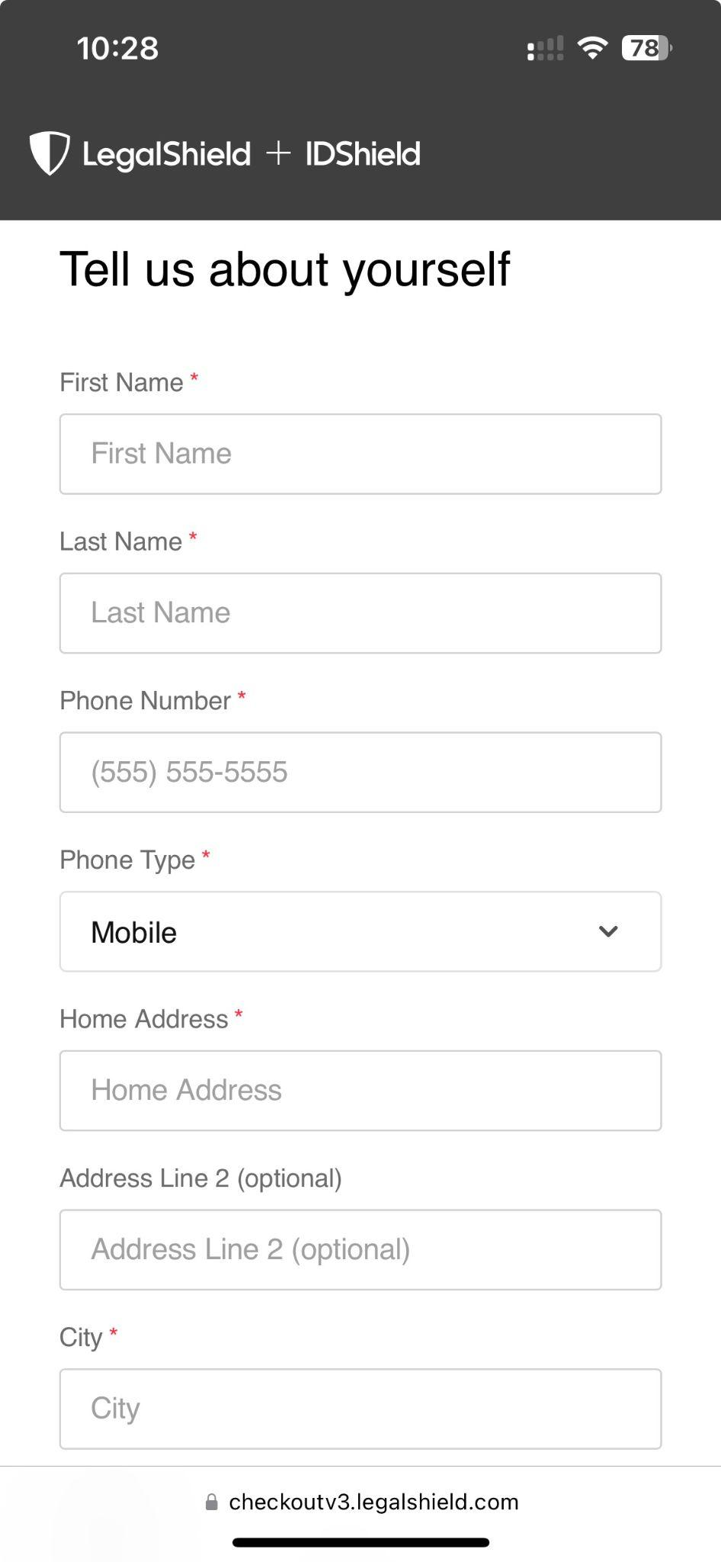
It only takes 3 minutes to enroll!
Getting Started is as Simple as 1, 2, 3!
1
Become a Member
2
Become an Associate
3
Get Trained & Get Paid
The business opportunity information is for use by LegalShield, its affiliates and its independent associates. No guarantee or promise of increased income or business is implied. Individual results and success as an independent sales associate depends on individual effort and abilities. For statistics on actual earnings, please review the Income Disclosure Statement available at opportunity.legalshield.com.

